Slide 1
E-MAIL SPAM DETECTION AND FILTERING
NIHIT PARIKH – 16BCP027
PARTH SHAH – 16BCP028

Slide 2
MOTIVATION
With ever increasing cybercrime and bullying, emails are one of the easiest way to Target innocent people over the internet to scam.
This will help users to differentiate from geniuine emails which they need v/s spam mails which includes unwanted offers from many corporates and scams
This will also help to keep the inbox clutter free

Slide 3
OBJECTIVE
Our team envisions to study different spam filtering techniques and specifically email spam detection and filtering techniques. With the use of Natural Language Processing, we intend to apply tokenization, lemmatization, and some such major concepts in achieving optimum efficiency of our email spam filter

Slide 4
SOCIAL APPLICATION
Spams are used daily by con artist all over the world to scam innocent people over the internet.
Spams are also sent to people against their wishes, and the inbox gets cluttered with unwanted offered from many corporates.
The purposes of spam and spam filters are diametrically opposed: spam is effective if it evades filters, while a filter is effective if it recognizes spam.
As new spam mails are recognized, update the spam filter accordingly.

Slide 5
DATASET
Euron dataset is taken for training and testing. The corpus contains over 33000 mails of employees
The mails are already classified into ham and spam
The link for the dataset - http://www2.aueb.gr/users/ion/data/enron-spam/

Slide 6
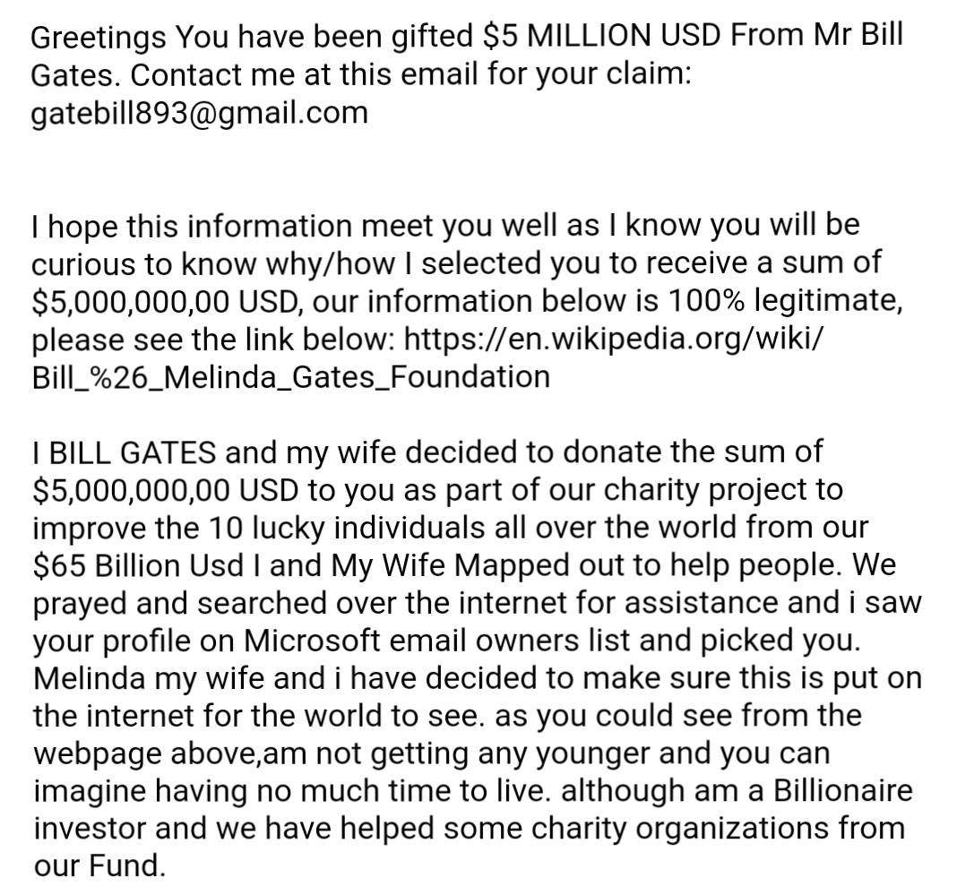

Slide 7
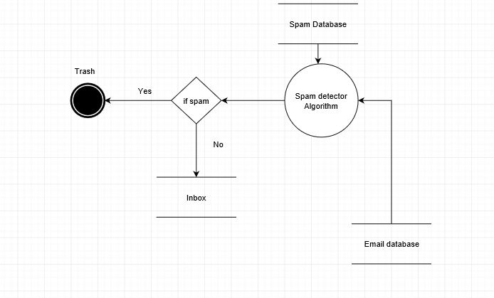

Slide 8
IMPLEMENTATION
NLTK library is imported to use certain functions stopwords, word_tokenize etc
Sklearn library is imported to use certain functions such as naïve bayes classifier etc
All the folders are iterated to read the ham and spam emails in the corpus
Ham and spam list is updated as the mails are read

Slide 9
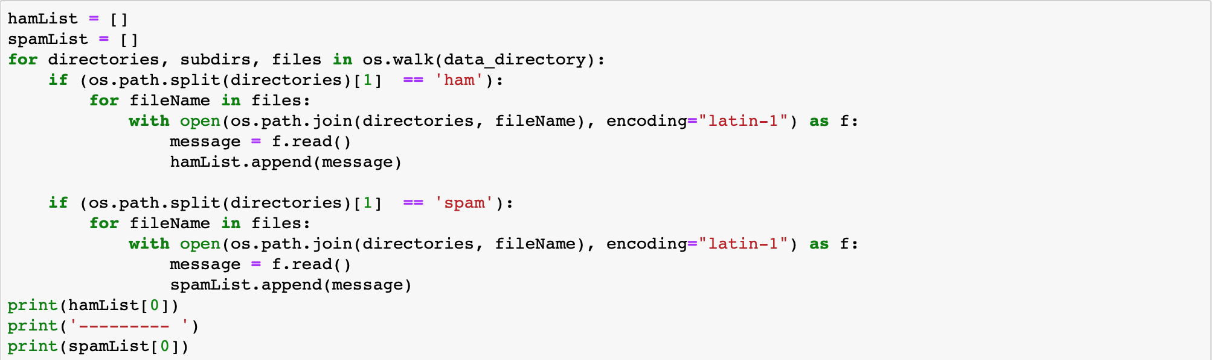
Files are read with encoding latin-1 as there are some special characters present in the mails

Slide 10
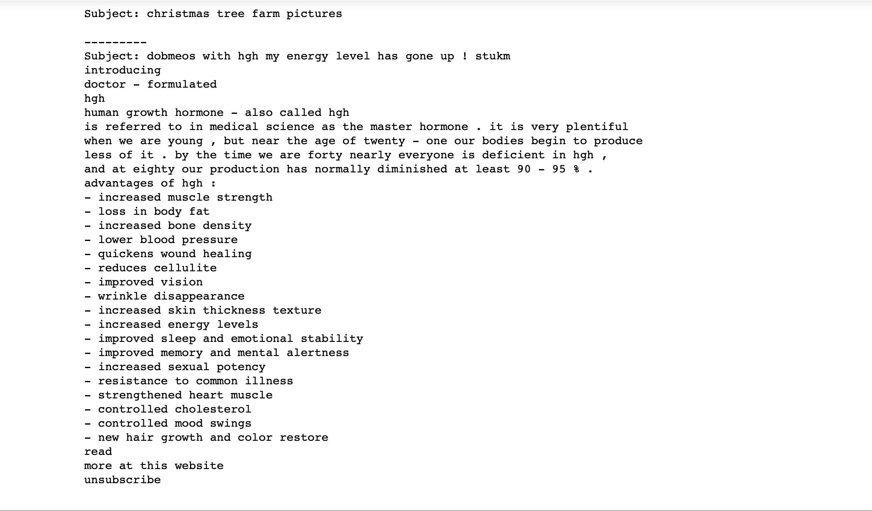

Slide 11
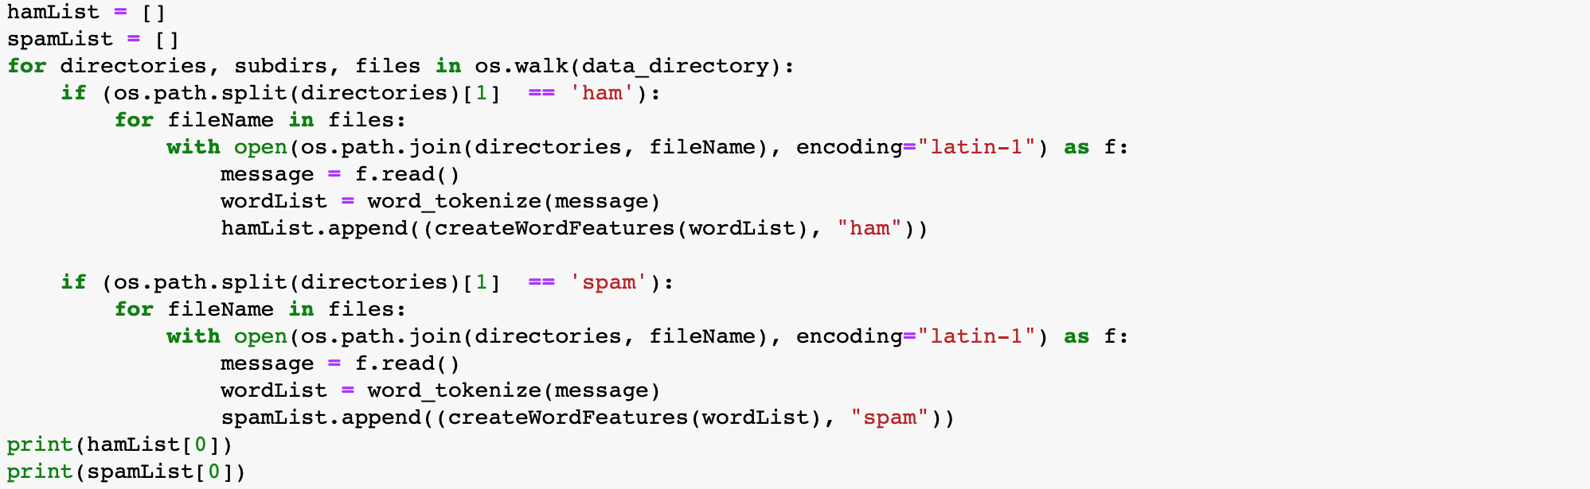
Naive Bayes expects the input in a particular format:
{Word1: True, Word2: True, Word3: True}

Slide 12
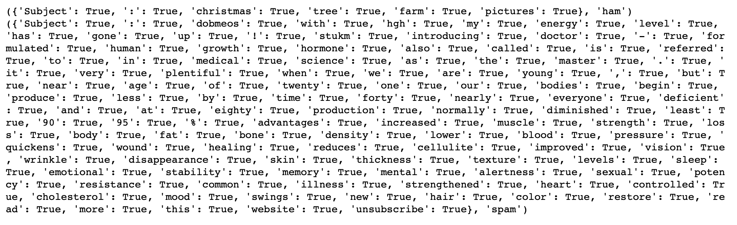

Slide 13
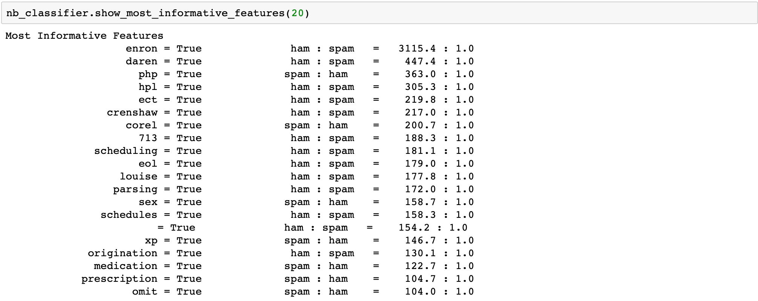
Comparing words which appear in both the datasets

Slide 14
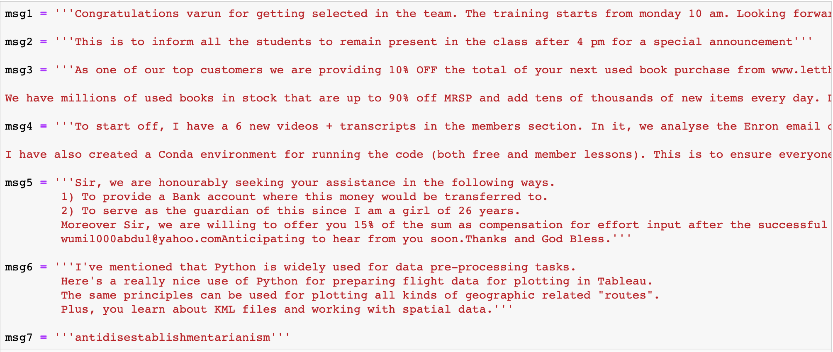
RESULT
Able to achieve an accuracy of 97%
Custom messages were also inputted which resulted in 100% accuracy

Slide 15
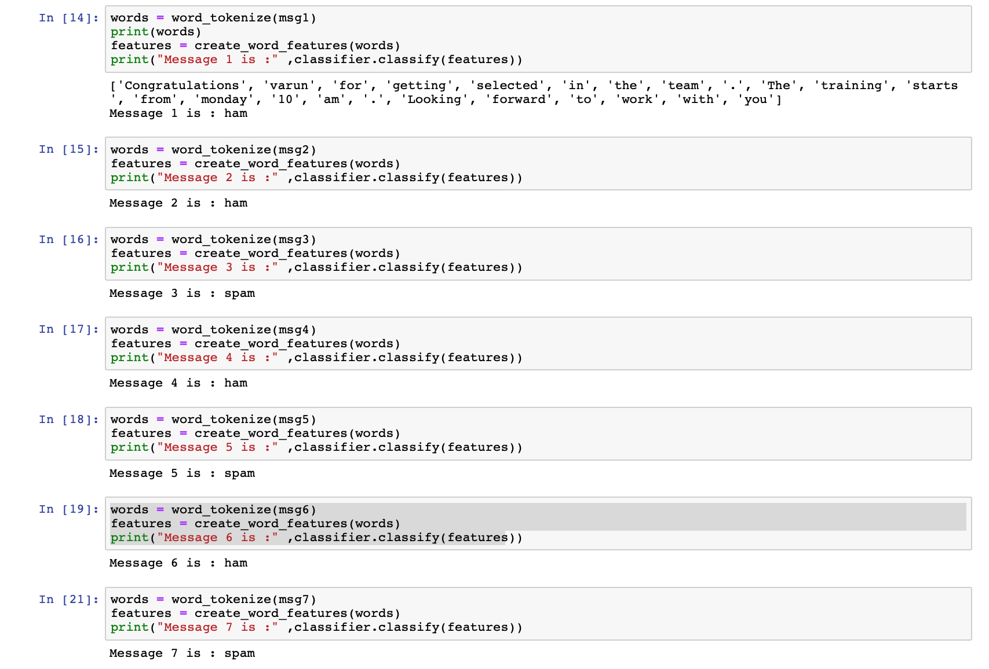

Slide 16
THANK YOU!

